Slide 1
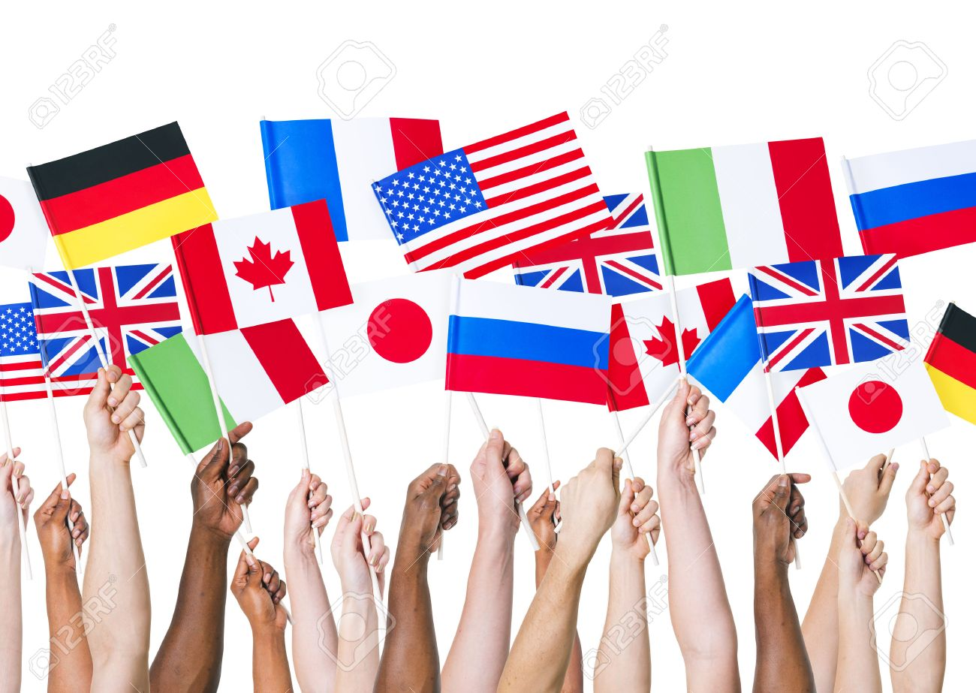
Citizenship
Respect and Responsibility

Slide 2
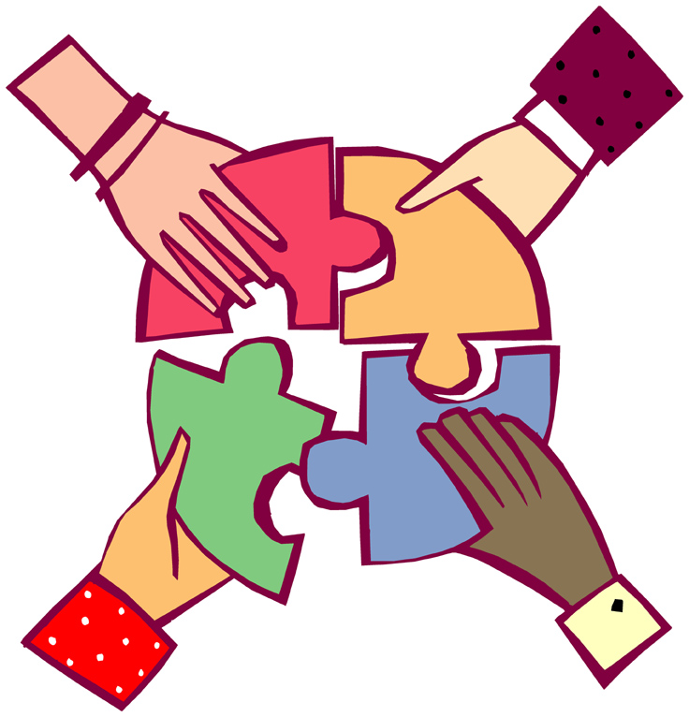
Titans celebrate virtue in scholarship, relationships, and citizenship.
What is citizenship?
the duties and functions of a citizen
using respect and responsibility to make your community a better place
Notes:
- here is the second line of the Creed as the title
- We are seeing what it means to have virtue in citizenship
- respect and responsibility are the two aspects of citizenship that we will explore in the powerpoint

Slide 3
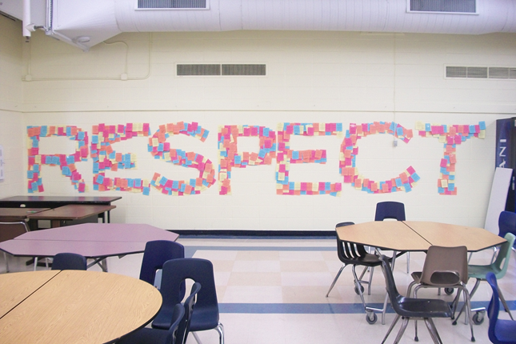
Our school demonstrates respect towards self, community, and the academic environment.
Questions:
What are some ways that you can show respect at school?
With family and friends?
Towards yourself?
Online?
Notes:
Being a Titan means that you take what you learn here at school and use it outside of school also
Respect here at school may be obvious but students can extend that to other people and other circumstances
Respecting themselves and respect shown online and with social media may be areas worth emphasizing or discussing

Slide 5
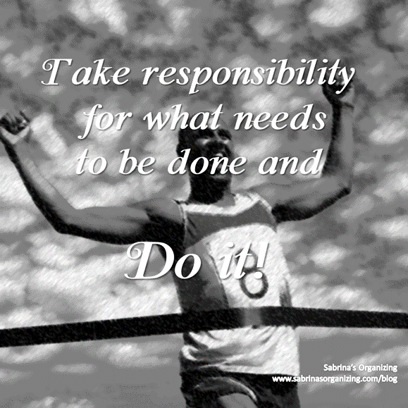
Being a Good Citizen
Citizenship means doing our share for our community and our country. Being a good citizen means caring about the good of society and participating actively to make things better.
Notes:
Here we start to move into responsibility
Being a good citizen means you do not just know what is right, but you recognize that you have a responsibility to do what is right
You could discuss right vs responsibilities here

Slide 6
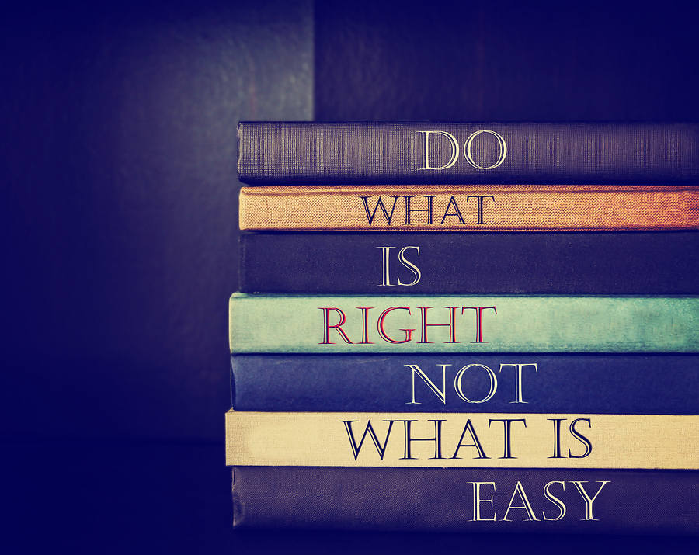
A Responsibility to do Good
“As a journalist, I'm a huge defender of The First Amendment, but I've also always thought of it as a starting point, a framework. It tells us the government can't restrict our speech, but what we do in our communities, businesses, in our media after that, that is up to us.”
- Vince Bzdek, journalist
Notes:
This emphasizes someone’s responsibility OVER their right
You could also discuss integrity here
You could also tie this into the previous idea of being respectful and responsible online

Slide 7
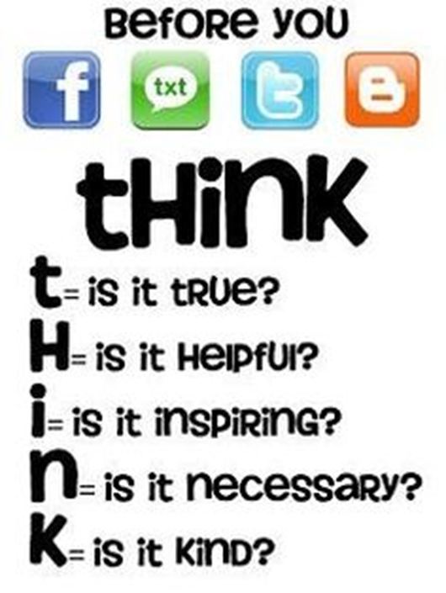
Even if you don’t see it, your words and actions affect the people around you.
You are a part of a community, so THINK before you act.
→ → →
Notes:
The picture says to THINK before using text, facebook, and other social media
Also see if there are ways to use these steps in person or in the classroom

Slide 8
Make your world better!
Video Link: 20 Things You Should Say More Often
Notes:
- This is not overtly about respect and responsibility but there are some great nuggets in here about including others and being kind that involves this idea of citizenship and community

Slide 9
Titans celebrate virtue in citizenship.
Look at these lines from the Titan’s Creed.
Titans endeavor to recognize and pursue truth, beauty, goodness.
Titans take ownership of and find joy in learning.
Titans strive to be our best, do our best, and give our best to the world.
How do we do this in our everyday lives? At school?
How do we do these things when we
interact with others?

